Slide 1
Cold Water Immersion &
Hypothermia
Paul Manicone, MD
Vice Commander
Herring Bay Flotilla
U.S. Coast Guard Auxiliary

Slide 2
Bad Decisions Make Great Stories
If you survive!

Slide 3
Heat Balance
Radiation
Evaporation
Convection
Conduction
Heat Production
Activity
Shivering
External Heat
Notes:
Water conducts heat 24X faster than air The human body is loaded with thermoreceptors which communicate with the hypothalamus.
Radiation: loss of heat through Infrared rays (like the sun)
Evaporation: Transfer of heat from water changing phase to gas (evaporation of sweat).
Conduction: physical contact
Convection: movement of air or water across your skin

Slide 4
Water vs. Air
Thermal Conductivity:
  Water: 0.6 W/mK
  Air: 0.025 W/mK
Ratio: 0.6/0.025 = 24
Water is 24 times more conductive than air!

Slide 5
Hypothermia
Severity | Core Body Temperature Range
Mild | 90-95 degrees F
Moderate | 82-89 degrees F
Severe | Less than 82 degrees F

Slide 6
Mild Hypothermia
Thermal Regulation intact
  Shivering
  Arms and Leg movements impaired
  Mental processing impaired

Slide 7
Moderate Hypothermia
Thermal Regulation failing
  Decreased Shivering
  Decreased Consciousness

Slide 8
Severe Hypothermia
Thermal regulation failure
  No shivering
  Unconscious
At risk for cardiac arrest

Slide 9
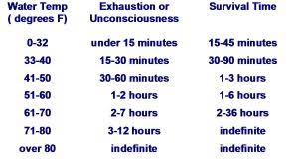
Surviving in Cold Water

Slide 10
Surviving in Cold Water
Notes:
41 – 50 degrees is the approximate water temperature for Fall and Spring boating

Slide 11
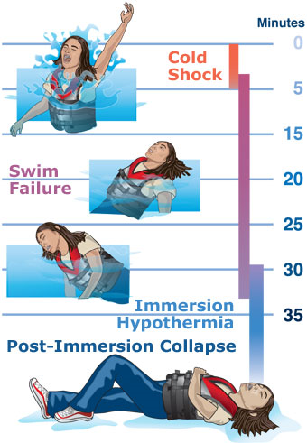
Surviving in Cold Water

Slide 12
Surviving in Cold Water
Reflexive Gasp can cause drowning

Slide 13
Surviving in Cold Water
10 minutes of purposeful movement before “cold incapacitation”.
Most deaths occur in this stage.

Slide 14
Surviving in Cold Water
Unconscious stage. Only possible to survive to this stage with flotation

Slide 15
Surviving in Cold Water
Drop in adrenaline production causes fainting and possibly cardiac arrest

Slide 16
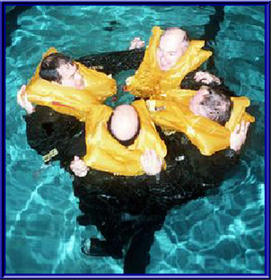
Surviving in Cold Water
Lifejacket should be on. Seek flotation
Control your breathing in first minute
Remain calm and still in water
Do not swim to shore
If possible stay with boat
Keep clothes on
If in a group, huddle
Attempt communication

Slide 17
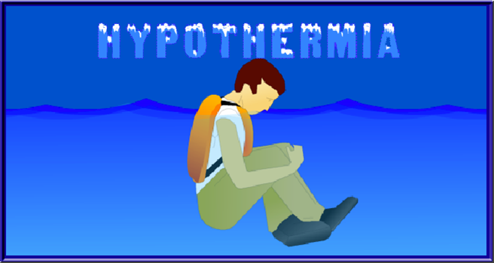
Surviving in Cold Water
HELP position (Heat Escape Lessening Position)

Slide 18
Prevention of a Person Overboard
Prevention is the key
  Always wear a PFD
  Do not sit on gunwale or bow
  Do not lean out of boat
  Use jacklines and tethers at night
  Dress appropriately for the conditions

Slide 19
Person Overboard: SAVE!
S: Spotter
A: Aids to floatation
V: VHF (notify Coast Guard)
E: Extraction Plan

Slide 20
Rescue & Treatment
Gentle and Horizontal
Remove wet clothing
Insulate victim: fully wrapped cocoon
Update Coast Guard
Be mindful of the “after drop” in core body temperature

Slide 21
Rescue & Treatment
Rescuer Safety first!
  Do not enter the water to perform a rescue
  Throw floatation to PIW
  Don the proper gear
  Notify Coast Guard Station (pan pan vs. may day)
  Make an extraction plan

Slide 22
Case Study #1
64 year old male departed Deale, MD on Wednesday November 6,2019 in a 28 foot fishing boat
Slept on boat and continued fishing the following day
Boat ran ashore on Kent Island, engine running. Local man reported sighting at 3:20pm.
Massive search conducted: State/Local/USCG
Victim’s body recovered 2 days later, 18 miles from scene. No PFD on victim.
Notes:
Victim’s phone was on board. Phone records indicate last contact was with a friend on 12:46 Thursday.
Assets deployed: CG Sector MD-NCR Command Center requested boat crews from MD DNR, Queen Anne County, MD DRN helicopter, Station Annapolis boat crew, CG helicopter from Air Station Atlantic City NJ. Fire boats from Kent Island and local volunteer fire department assisted.

Slide 23
Case #1 Analysis
NOAA satellite: water temp. 59 degrees
50-60 degrees considered ‘very dangerous’ and ‘immediately life threatening’
  Exhaustion: 1-2 hours Survival: 1-6 hours
Flotation: none
Insulation: none
Communication: none
Notes:
National Center for Cold Water Study

Slide 24
Risk Mitigation
What could this victim have done to increase his odds of survival?
Wear a PFD
Wear Floatation coat or Immersion suit
Carry phone in dry bag
Carry a handheld VHF radio
Wear PLB
Ignition kill switch
Buddy aboard
Avoid alcohol

Slide 25
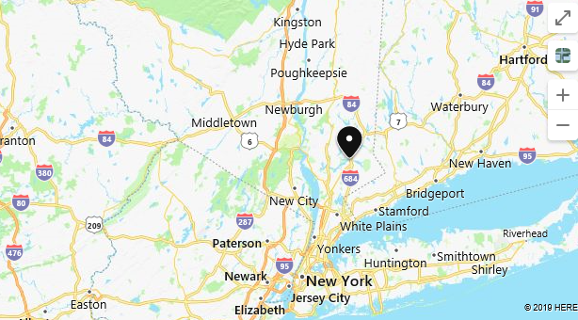
Case Study #2
Muscoot Reservior, NY
Notes:
Part of NYC water supply system, tributary of Hudson River. Contains Bass, Trout, Perch and Carp

Slide 26
Case Study #2
January 2, 2019; Fishing in Muscoot Reservoir
2 men: 47 & 48 years old
12 foot Aluminum rowboat
Began fishing at 14:00
Spoke with relatives at 17:00; stated they intended to keep fishing as rain fell and sunset
Found at 07:00 the following day: boat capsized. Bodies found with PFDs on.

Slide 27
Case Analysis
Water Temperature: 38 degrees
  Exhaustion: 15-30 min Survival: 30-90 min
Risks: tender open rowboat; raining; sunset
Causes of death:
    47 year old man: Hypothermia
    48 year old man: Asphyxiation due to cold water drowning; hypothermia

Slide 28
Case Analysis
Flotation: Yes. PFDs
Insulation: None
Communication: None on their person

Slide 29
Risk Mitigation
What could these victims have done to increase their odds of survival?
Wear Immersion suit or Dry suit
Huddle together; HELP position
Attach whistle to PFD
Carry phone in dry bag
Carry a handheld VHF radio
Wear PLB

Slide 30
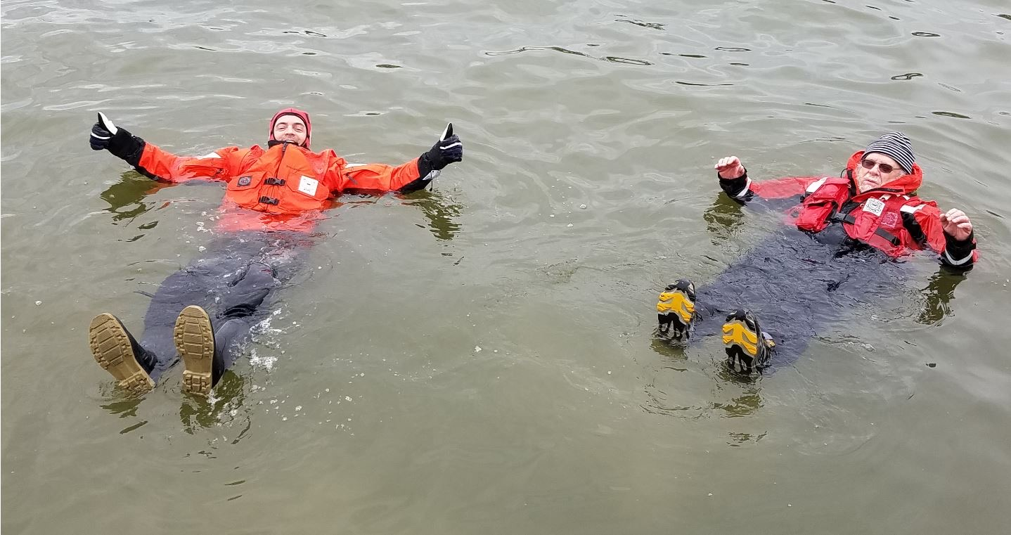
My Cold Water gear…

